Slide 1
Chapter 2: subject matter

Slide 2
Bellringer-August 18
Read/Scim through 2.1

Slide 3
Art and Reality
Representational- art that depicts the appearance of things
Abstract- Works of art that have no reference at all to natural objects or works that depict art in a simplified, distorted, or exaggerated way.
Nonrepresentational- (nonobjective) art that visual forms with no specific references to anything outside themselves.

Slide 4
Representational Art
The most “real-looking” artworks are in a style called trompe l’oeil, which is French for fool the eye. It is impressive to paint/create this way because it looks so real.

Slide 5
Representational Art
William Harnett- A Smoke Backstage 1877 oil on canvas

Slide 6
Abstract Art
The Term abstract means “to take from”, to extract the essence of the object or idea.
Many artist will change the object’s natural appearance in order to emphasize certain qualities.

Slide 7
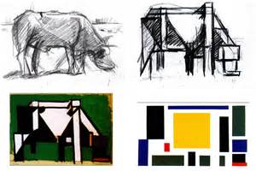
Abstract Art
Theo Van Doesburg Abstraction of Cow series 1917-1918

Slide 8
Nonrepresentational Art
These artworks are meant to be presented as “pure works” and “pure forms of visual art”. This can be easily confused with abstract art, however, the difference is that Abstract art usually starts out having a subject that gets broken down. Nonrepresentational art never had a subject to being with.

Slide 9
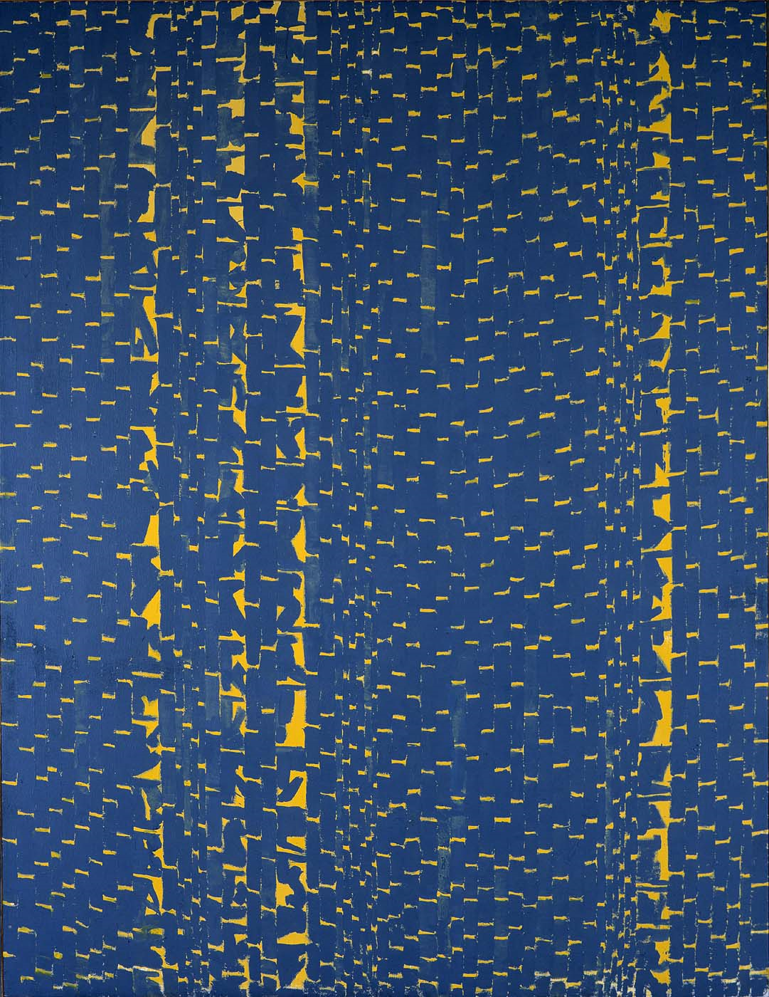
Nonrepresentational Art
Alma Woodsey Thomas Gray Night Phenomenon 1972
This is considered nonrepresentational because is has no subject and is expressive

Slide 10
Wassily Kandinksy-Several Circles
Is it abstract, nonrepresentational or representational?

Slide 11
Is this abstract, representational or nonrepresentational?

Slide 12
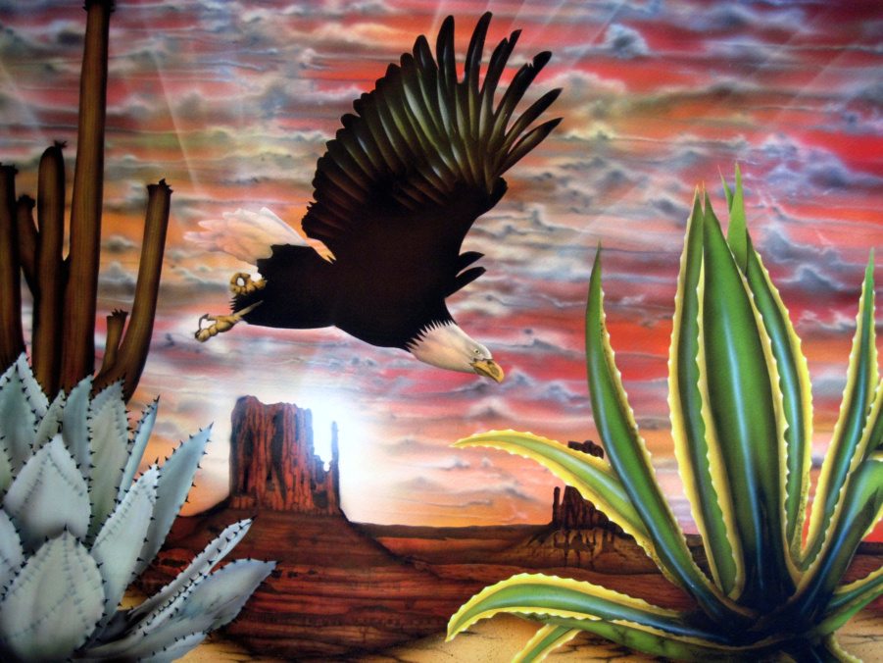
Is this abstract, representational or nonrepresentational?

